Slide 1
The Popper Convention: Practical Reproducible Evaluation of Systems
Ivo Jimenez, Michael Sevilla, Noah Watkins, Carlos Maltzahn (UC Santa Cruz)
Jay Lofstead (SNL)
Kathryn Mohror, Adam Moody (LLNL)
Andrea Arpaci-Dusseau, Remzi Arpaci-Dusseau (UW-M)
Notes:
Today I’m introducing the popper convention, an experimentation methodology that we have developed in collaboration with folks at Sandia, Lawrence Livermore and University of Wisconsin Madison.
The main goal of the Popper convention is to help researchers to produce experiments that are easily reproducible

Slide 2
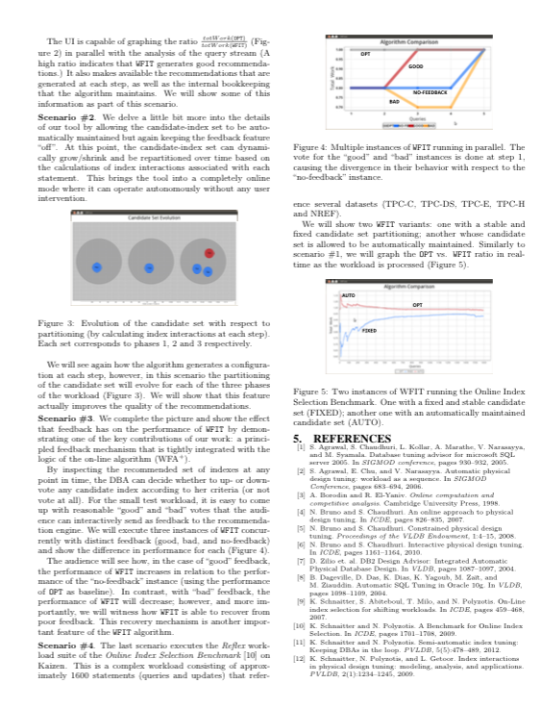
Problem of Reproducibility in Computation and Data Exploration
What compiler was used?
Which compilation flags?
How was subsystem X configured?
How does the workload look like?
What if I use input dataset Y?
And if I run on platform Z?
…
Notes:
To motivate the discussion about the Popper convention, let me go over a scenario I’m sure many of you have experienced
And at this point, one would like to have..

Slide 3
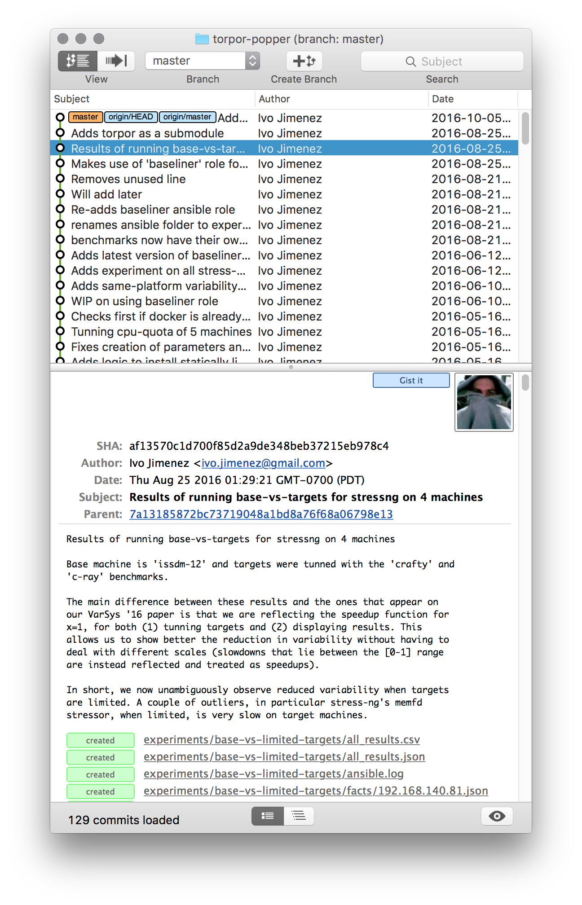
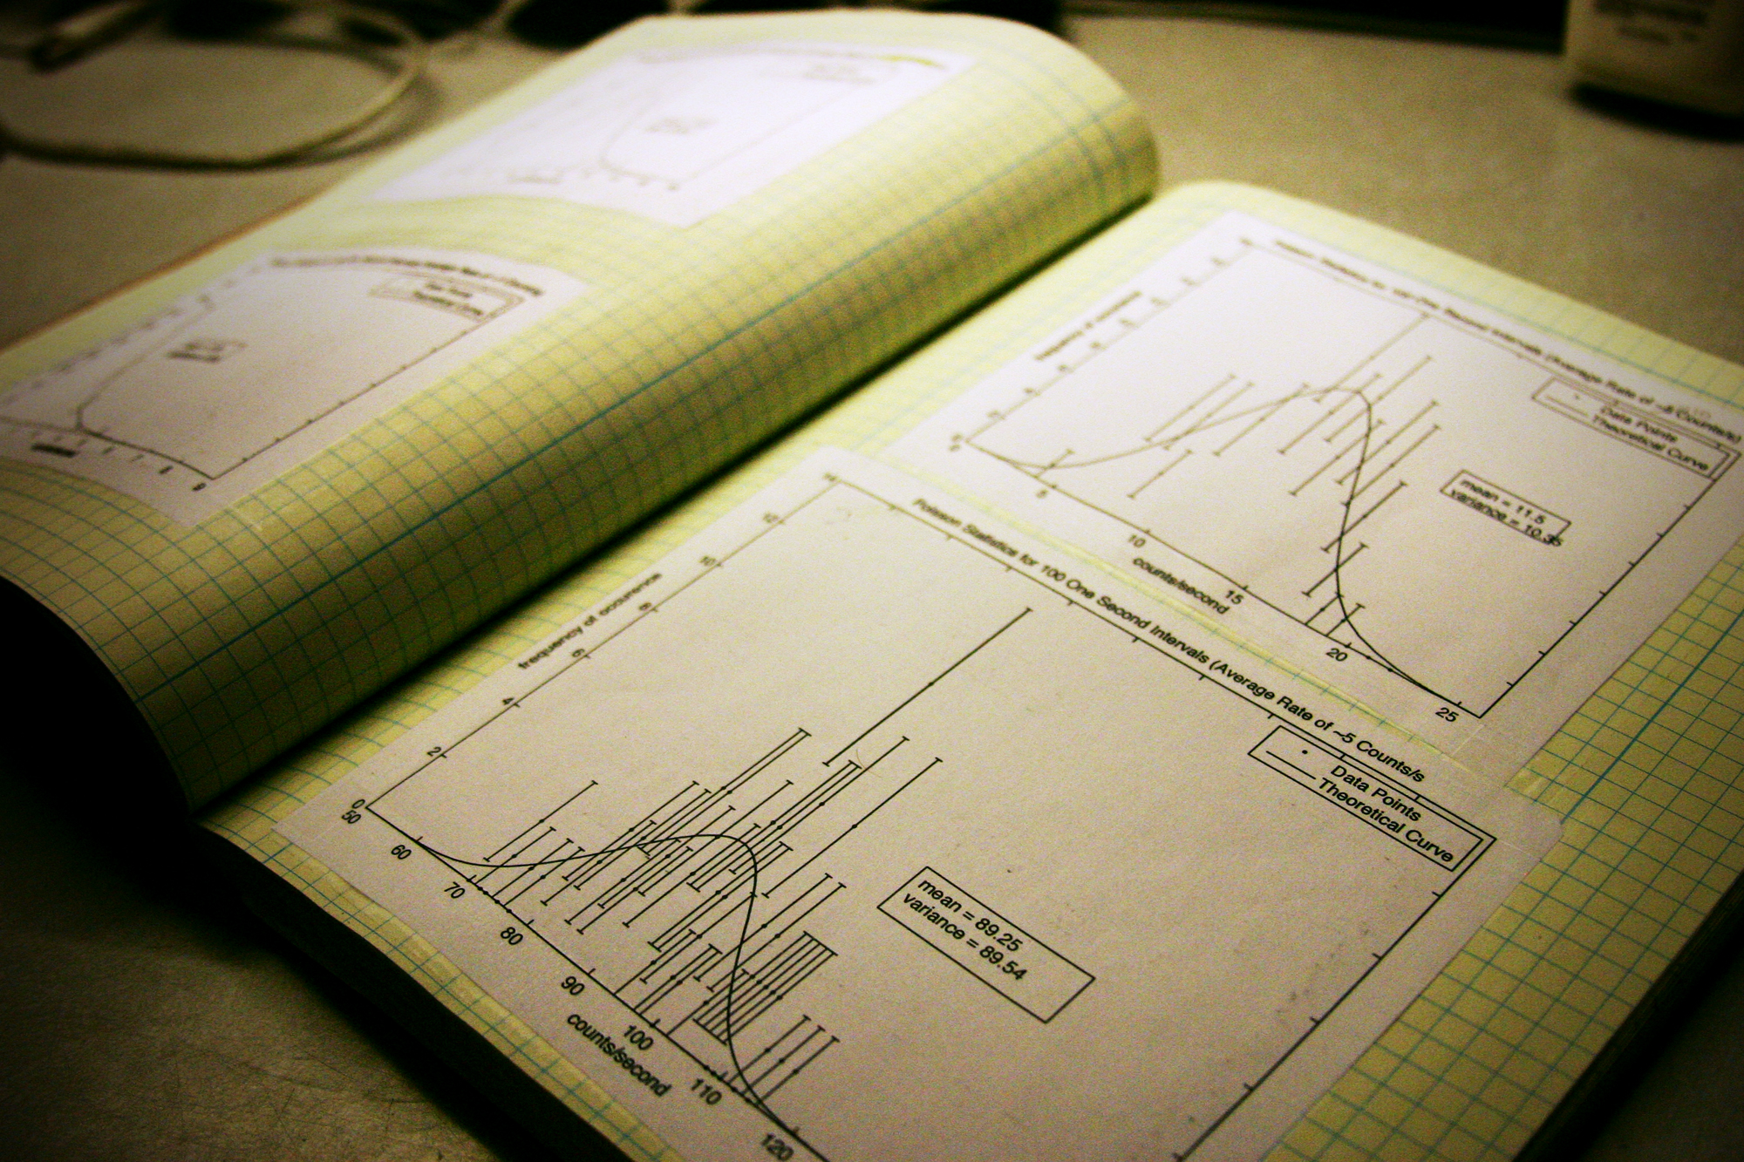
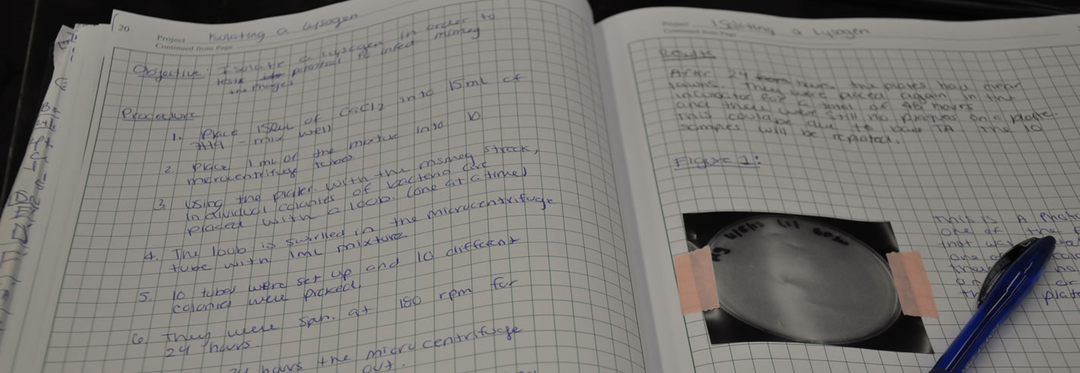
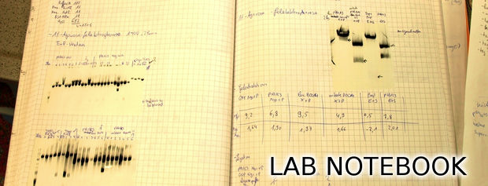
Lab Notebook
Notes:
In some sense, one would want to have the equivalent of what researchers in experimental sciences have: the lab notebook to document my experiment.
If our experiments are mostly code, then one way to look at this is as if we had the source code (of the EXPERIMENT) and a log (the commit log) detailing the evolution of the experiment over time
But just putting all the experiment’s artifacts in a version control system doesn’t make an experiment

Slide 4
Common Experimentation Workflow
Code
Package
Execute
Output Data
Analyze/
Visualize
Manuscript
Input Data
Notes:
So how do we go about organizing an experiment’s assets?
We can abstract and experiment…

Slide 5
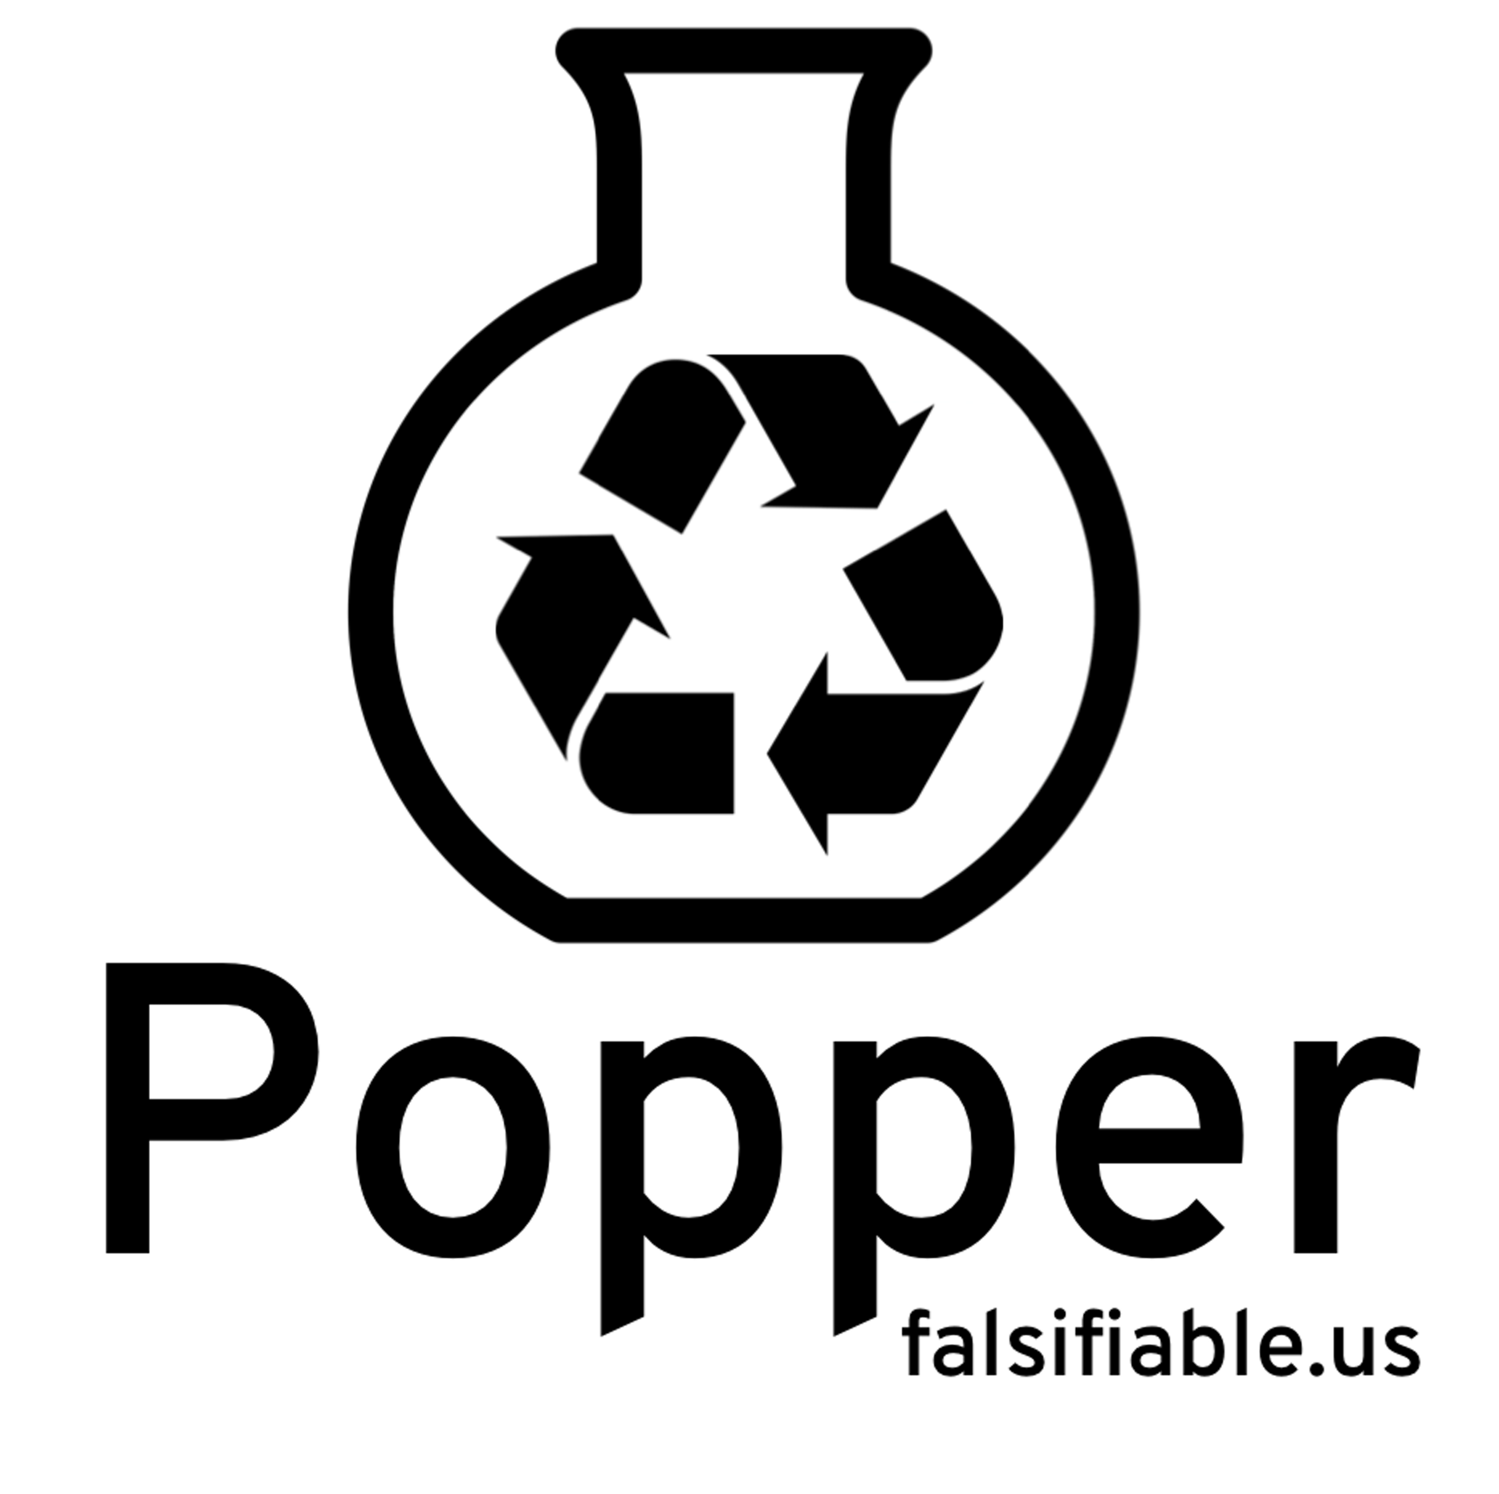



















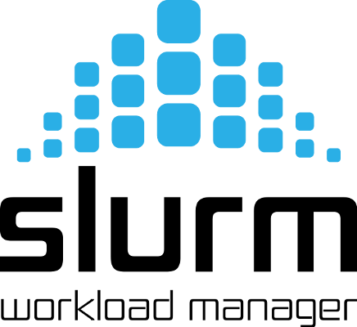




Code
Package
Execute
Output Data
Analyze/
Visualize
Manuscript
Input Data
Notes:
There are many analogies that we can draw from this workflow and what people do in the software engineering world
The Popper convention is just a series of high-level steps (an experimentation protocol, if you will) that outline how to implement a scientific exploration, so that reproducing it is easier.
These steps are 3 …

Slide 6
Pick a DevOps tool for each stage.
Each component of experimentation workflow.
Put all associated scripts in version control.
Make experiment self-contained.
Document changes as experiment evolves.
In the form of commits.
Notes:
In terms of an imperative list of steps, this is what it means to follow the Popper convention (or methodology)
DevOps tool doesn’t have to be OSS, as long as the scripts are available (e.g. .m files for matlab)

Slide 7
Popper-compliant Experiments
An experiment is Popper-compliant if all of the following is available (self-contained) and running correctly:
Experiment code
Orchestration
Data dependencies
Parameterization
Results
Validation
Notes:
By following this approach, at the end we have, what we called a Popper-compliant experiment.

Slide 8
Popper-CLI
$ cd mypaper-repo
$ popper init
-- Initialized Popper project mypaper-repo
$ popper experiment list
-- available templates ---------------
ceph-rados proteustm mpip adam sirius comd-openmp
cloverleaf gassyfs zlog bww unum-py cuddn-deeplrn
spark-bench torpor malacology genevo mantle rita-idx
hadoop-yarn kubsched alg-encycl macrob dadvisor obfuscdata
$ popper experiment add gassyfs
-- Added gassyfs experiment to mypaper-repo
$ popper experiment init mynewexp
-- Initialized mynewexp experiment in mypaper-repo
Notes:
To facilitate the generation of popper-compliant experiments
We provide a CLI tool that provides curated experiment templates. It also helps to bootstrap experiments that are Popper-compliant (experiment scaffolding feature).

Slide 10
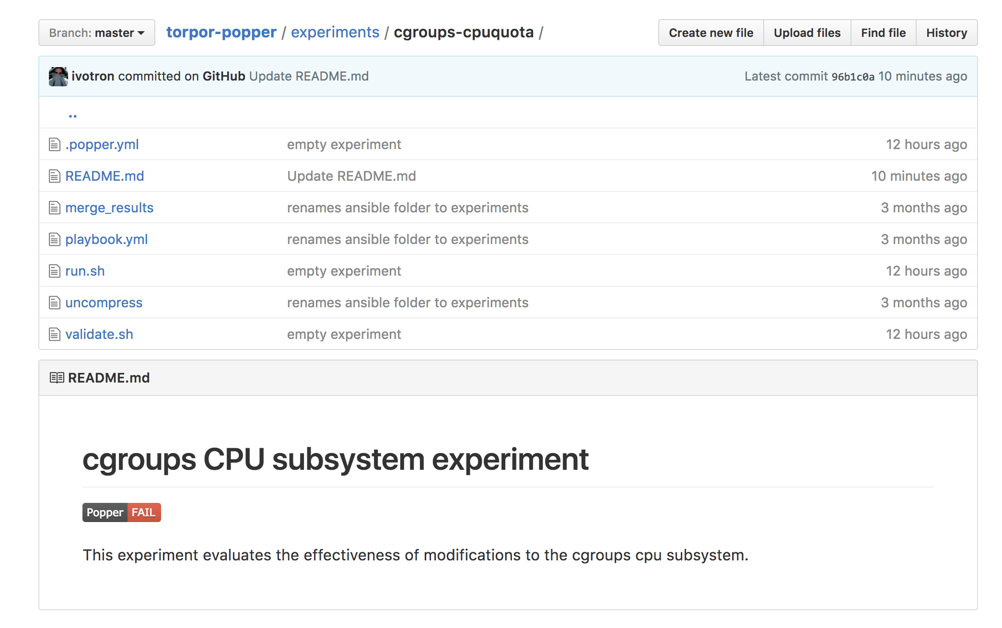


Automated Validation
Notes:
We also maintain a RESTful service at popper-status.falsifiable.us that makes it easier to track the status of an experiment . This also serves badges that can be used in README files of an experiment to display the current status of an experiment.

Slide 11
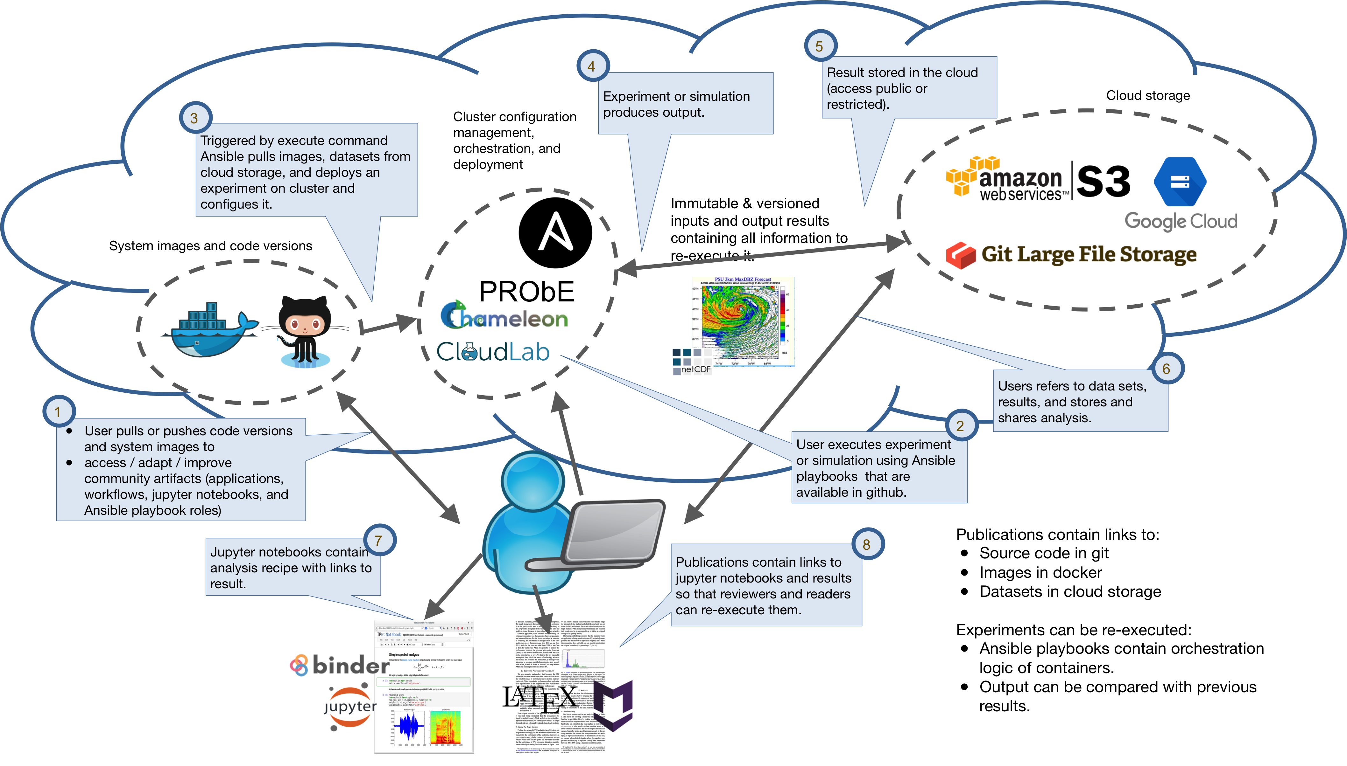
Reviewer/Reader Workflow
Notes:
This shows the workflow that someone repeating a Popperized experiment follows, for a particular toolchain (docker, ansible, Jupyter, LATeX and S3).
We leverage shared resources (NSF-sponsored Chameleon/Cloudlab and DOE’s PRObE) to re-execute experiments.

Slide 12
Other Use Cases
Parallel Algorithms Encyclopedia
ctuning extended artifact description
HPC Proxy applications (mini-apps)
Elsevier’s 2011 executable paper challenge

Slide 13
Communities
Numerical weather prediction as part of the Big Weather Web (bigweatherweb.org)
Distributed Systems (UCSC / UW Madison)
Game design as part of the generative methods effort at the (UCSC Augmented Design Lab)
HPC at LLNL and Sandia
Genomics at UCSC

Slide 14
Analogies with DevOps Practice
Scientific exploration | Software project
Experiment code | Source code
Input data | Test examples
Analysis / visualization | Test analysis
Validation | CI / Regression testing
Manuscript / note book | Documentation / reports
Key Idea: manage a scientific exploration like software projects
Notes:
Software engineers deal with reproducibility all the time: “reproduce bug on version x with parameters y using data z”
Naturally, they’ve developed sophisticated techniques and tools to deal with this. Why don’t we leverage this?
Many open source, mature tools available for us so that we can treat a scientific exploration as a software project
But how do we structure a project, from the point of view of ?

